Slide 1

COMPUTER NETWORKING
LAB 4

Slide 2
Dynamic Routing
OSPf single-area configuration

Slide 3
OBJECTIVES
Configuration of the Router-ID for OSPF.
Establish OSPF on a specified interface or network. View OSPF operations using display commands. Advertisement of default routes in OSPF.
Change of the OSPF hello interval and dead interval. Familiarization with DR or BDR election on multi-access networks. Change of the OSPF route priority to manipulate DR election.

Slide 4
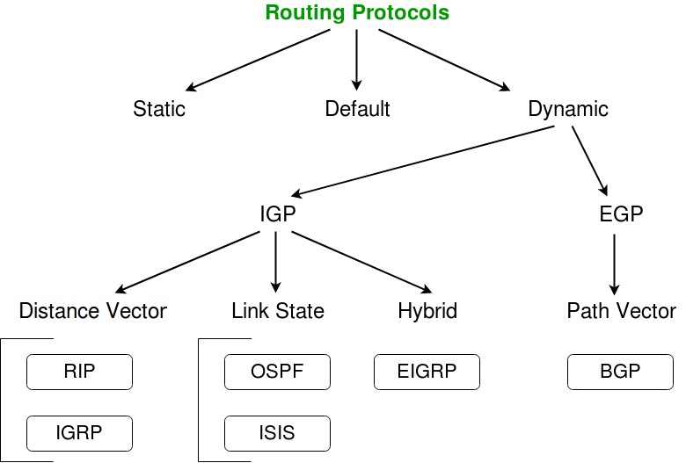
Illustration of Routing Protocols
in Computer Network
Sources: https://www.geeksforgeeks.org

Slide 5
Dynamic routing
Advantages over routing
Dynamic routing is a networking technique that provides optimal data routing. Unlike static routing, dynamic routing enables routers to select paths according to real-time logical network layout changes.
No need to know the destination networks
Updates the topology changes dynamically
Administrative work is reduced
Used for large organizations
OSPF Areas
OSPF Rules Includes:
The Open Shortest Path First (OSPF) protocol is a link-state hierarchical routing protocol primarily used within larger autonomous system networks.
Must have one area called as area 0
All areas must connect to area 0

Slide 6
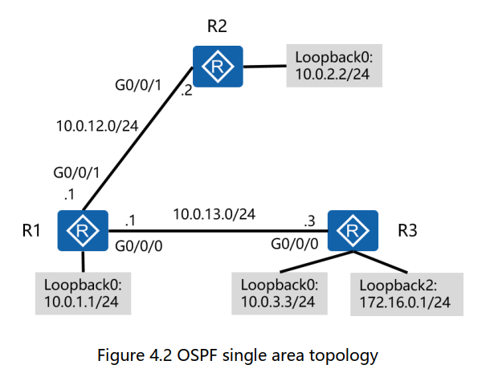
Topology

Slide 7
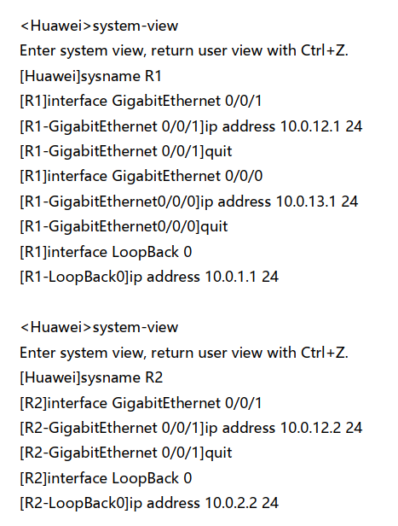
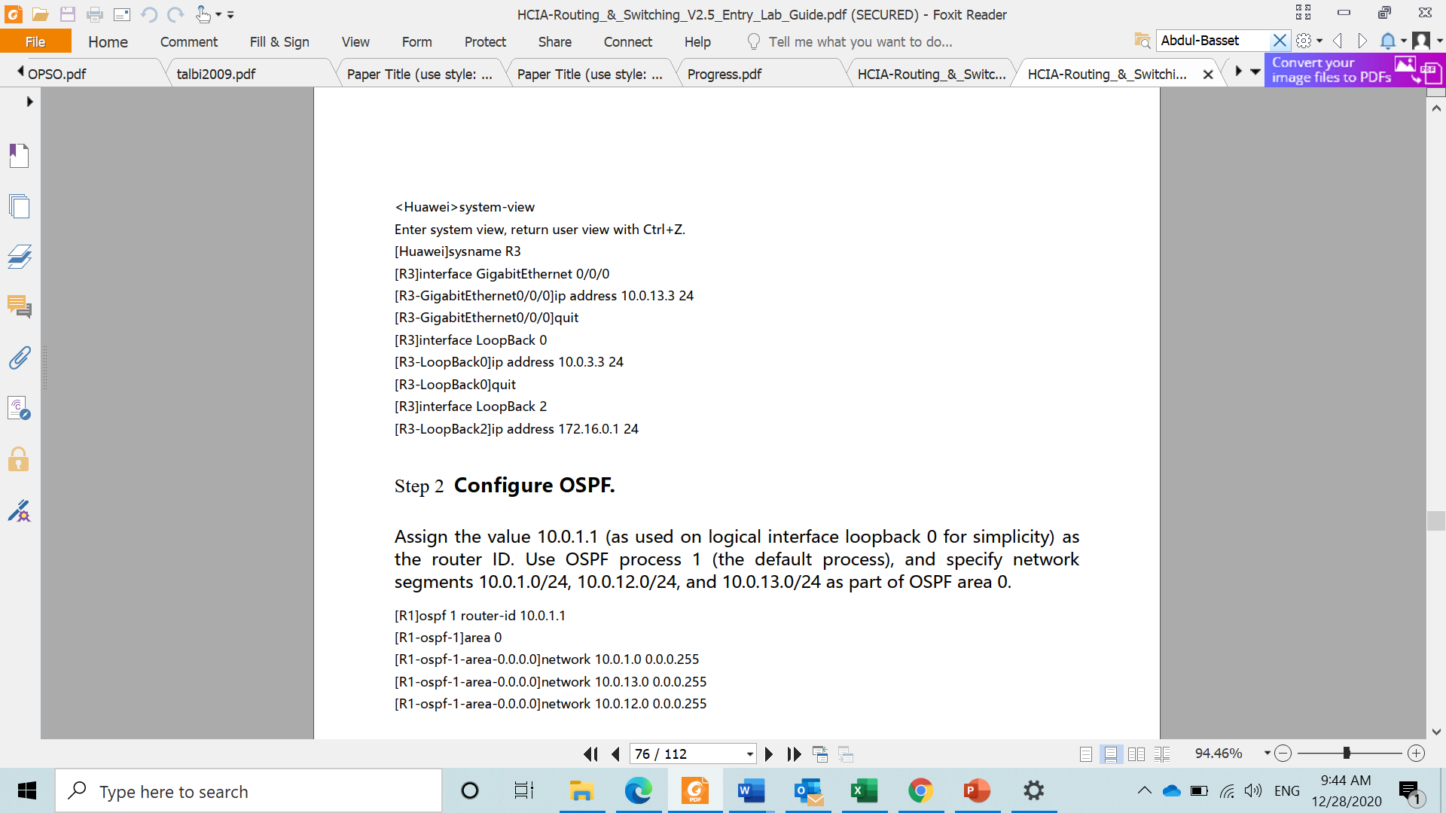
Prepare the environment
Establish the basic system configuration and addressing for the lab

Slide 8
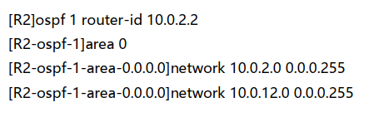
Configure OSPF
Assign the value 10.0.1.1 (as used on logical interface loopback 0 for simplicity) as the router ID.
Use OSPF process 1 (the default process ), and specify network segments 10.0.1.0/24, 10.0.12.0/24, and 10.0.13.0/24 as part of OSPF area 0.
Manually assign the value 10.0.2.2 as the router ID. Use OSPF process 1 and advertise network segments 10.0.12.0/24 and 10.0.2.0/24 into OSPF area 0.

Slide 9
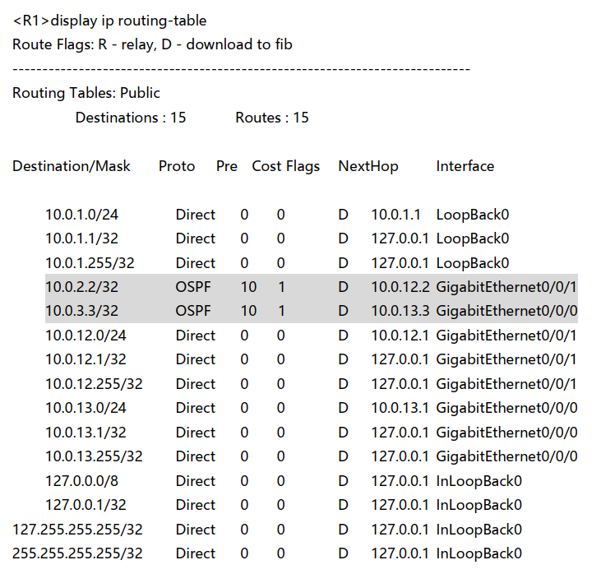
Verify OSPF configuration
After OSPF route convergence is complete, view routing tables of R1, R2 and R3.

Slide 10
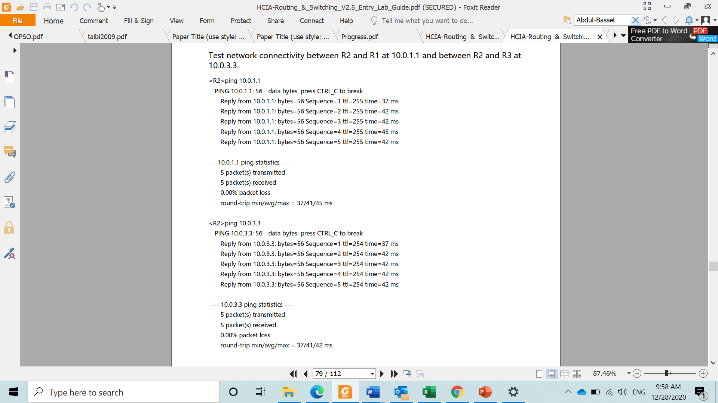
Test connectivity
Use the ping command to test network connectivity between and R1 and between R2 and R3 at 10.0.3.3.

Slide 11
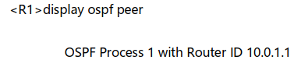
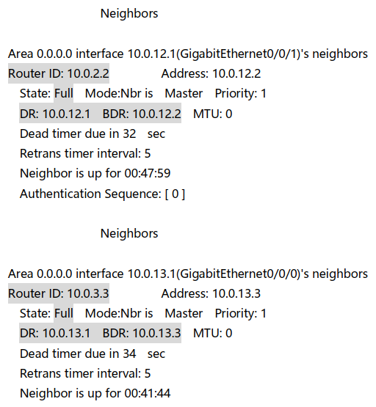
Test connectivity
Run the display ospf peer command to view the OSPF neighbor status.
The routing table does not contain the routes of the two networks.
The display ospf peer command displays detailed information about aany peering neighbors,

Slide 12
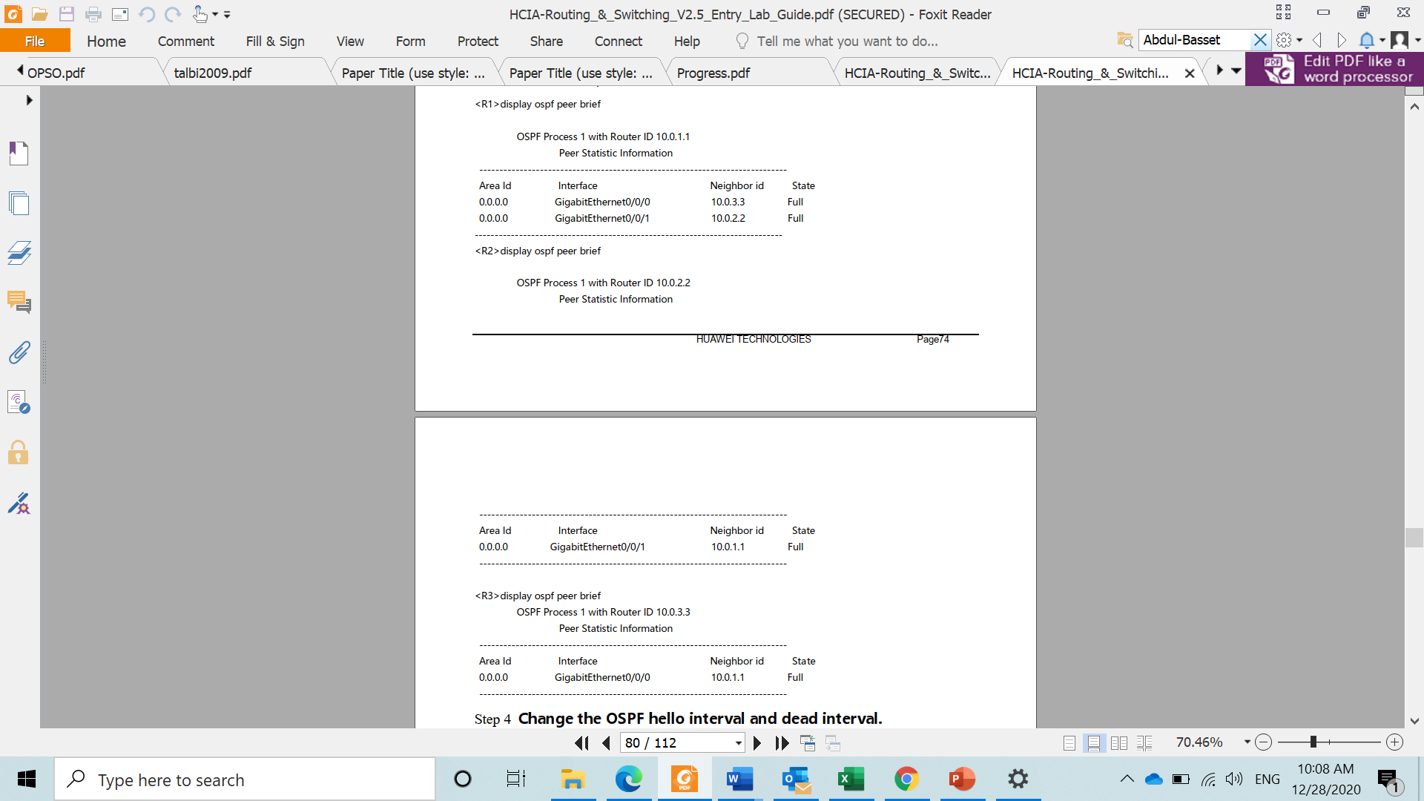
View Routing
The display ospf peer brief command can also be used to display a condensed version of the OSPF peer information.

Slide 13
Thank you

